Slide 1
Supporting Procedures in Computer
Hardware
CSE-3109 Computer Architecture
Lecture 6

Slide 2
Introduction
In executing a procedure, the program must follow these six steps:
Place parameters in a place where the procedure can access them.
Transfer control to the procedure.
Acquire the storage procedure needed by the procedure.
Perform the desired task.
Place the result value in a place where the calling program can access them.
Return control to the point of origin, since a procedure can be called from several points in a program.

Slide 3
Cont.
Registers used in procedure calling:
MIPS software follows the following convention for procedure calling in allocating its 32 registers:
$a0--$a3: Four argument registers in which to pass parameters.
$v0--$v1: Two value registers in which to return values.
$ra: One return address register to return to the point of origin.

Slide 4
Cont.
In addition to allocating these registers, MIPS assembly language includes an instruction just for the procedures: it jumps to an address and simultaneously saves the address of the following instruction in register $ra.
The jump-and-link instruction (jal) is simply written
jal ProcedureAddress

Slide 5
Cont.
The link portion of the name means that an address or link is formed that points to the calling site to allow the procedure to return to the proper address.
This “link,” stored in register $ra (register 31), is called the return address. The return address is needed because the same procedure could be called from several parts of the program.

Slide 6
Cont.
To support such situations, computers like MIPS use jump register instruction (jr), meaning an unconditional jump to the address specified in a register:
jr $ra
Jump register instruction jumps to the address stored in register $ra
Thus, the calling program, or caller, puts the parameter values in $a0-$a3 and uses jal X to jump to procedure X (sometimes named the callee). The callee then performs the calculations, places the results in $v0 and $v1, and returns control to the caller using jr $ra.

Slide 7
Cont.
Execution Sequence Using MIPS instruction:
The calling program puts the parameter values in $a0--$a3.
Use jal X (jump and link) to jump to the procedure. [X is the name of the called procedure]
The jal saves the return address (the address of the next instruction)
in the dedicated register $ra, before jumping to the function.
Procedure X performs the calculations.
Place the result in $v0--$v1.
Return control to the calling program using jr (jump register) $ra.

Slide 8

Where are the registers saved?
It would be nice if each function call had its own private memory area.
This would prevent other function calls from overwriting our saved registers.
We could use this private memory for other purposes too, like storing local variables.

Slide 9
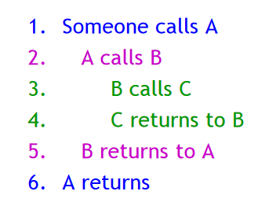
Function calls and stacks
Notice function calls and returns occur in a stack-like order: the most recently called function is the first one to return.
Here, for example, C must return to B before B can return to A.

Slide 10
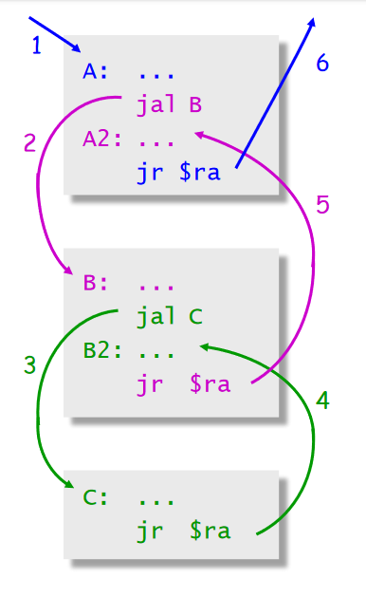
Function calls and stacks

Slide 11

Stacks and function call
It’s natural to use a stack for function call storage. A block of stack space, called a stack frame, can be allocated for each function call.
When a function is called, it creates a new frame onto the stack, which will be used for local storage.
Before the function returns, it must pop its stack frame, to restore the stack to its original state.

Slide 12
Stacks and function call
The stack frame can be used for several purposes.
  Caller- and callee-save registers can be put in the stack.
  The stack frame can also hold local variables, or extra arguments and return values.

Slide 13
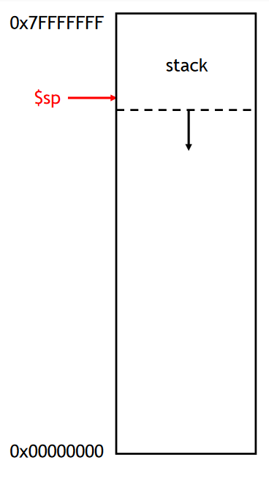
The MIPS stack
In MIPS machines, part of main memory is reserved for a stack.
  The stack grows downward in terms of memory addresses.
  The address of the top element of the stack is stored (by convention) in the “stack pointer” register, $sp.
MIPS does not provide “push” and “pop” instructions. Instead, they must be done explicitly by the programmer.

Slide 14
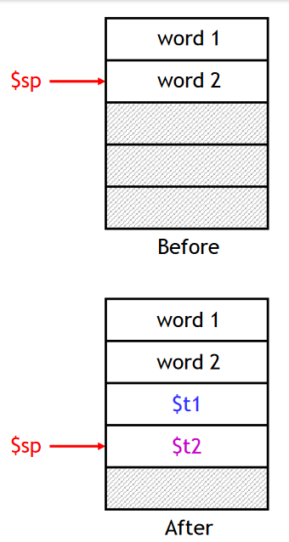
Pushing elements
To push elements onto the stack:
  Move the stack pointer $sp down to make room for the new data.
  Store the elements into the stack.
For example, to push registers $t1 and $t2 onto the stack:
sub $sp, $sp, 8
sw $t1, 4($sp)
sw $t2, 0($sp)

Slide 15
Pushing elements
An equivalent sequence is:
sw $t1, -4($sp)
sw $t2, -8($sp)
sub $sp, $sp, 8

Slide 16
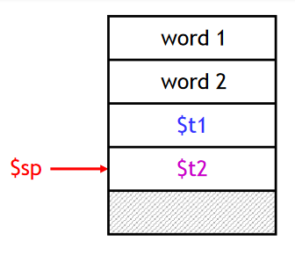

Accessing and popping element
You can access any element in the stack (not just the top one) if you know where it is relative to $sp.
For example, to retrieve the value of $t1:

Slide 17
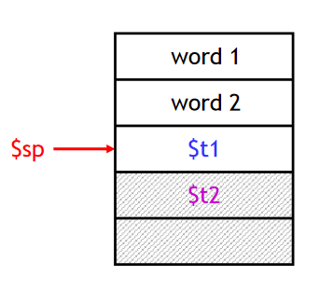

Accessing and popping element
You can pop, or “erase,” elements simply by adjusting the stack pointer upwards.
To pop the value of $t2, yielding the stack shown at the bottom:
Note that the popped data is still present in memory, but data past the stack pointer is considered invalid.

Slide 18
Cont.
MIPS software reserves register 29 for the stack pointer, Stacks “grow” from higher addresses to lower addresses. This convention means that you push values onto the stack by subtracting from the stack pointer.

Slide 19
Example
    int leaf_example (int g, int h, int i, int j)
    {
    int f;
    f = (g + h) – (i + j);
    return f;
    }
What is the compiled MIPS assembly code?

Slide 20
Example
    int leaf_example (int g, int h, int i, int j)
    {
    int f;
    f = (g + h) – (i + j);
    return f;
    }
What is the compiled MIPS assembly code?
The parameter variables g, h, i, and j correspond to the argument registers $a0, $a1, $a2, and $a3, and f corresponds to $s0. The compiled program starts with the label of the procedure:
leaf_example:

Slide 21
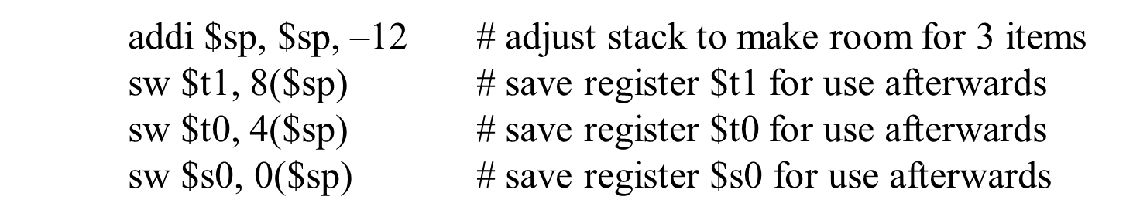
Solution
The next step is to save the registers used by the procedure. We need to save three registers: $s0, $t0, and $t1.
We “push” the old values onto the stack by creating space for three words (12 bytes) on the stack and then store them.

Slide 22
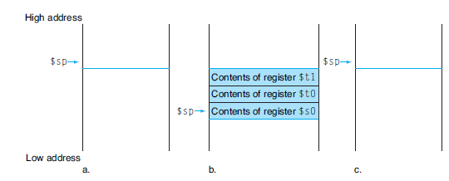
Cont.
addi $sp, $sp, –12 # adjust stack to make room for 3 items
sw $t1, 8($sp) # save register $t1 for use afterwards
sw $t0, 4($sp) # save register $t0 for use afterwards
sw $s0, 0($sp) # save register $s0 for use afterwards
FIGURE : The values of the stack pointer and the stack (a) before, (b) during, and (c) after the procedure call. The stack pointer always points to the “top” of the stack, or the last word in the stack in this drawing.

Slide 23
Cont.
The next three statements correspond to the body of the procedure,
add $t0,$a0,$a1 # register $t0 contains g + h
add $t1,$a2,$a3 # register $t1 contains i + j
sub $s0, $t0, $t1 # f = $t0 – $t1, which is (g + h)–(i + j)
To return the value of f, we copy it into a return value register:
add $v0,$s0,$zero # returns f ($v0 = $s0 + 0)

Slide 24
Cont.
Before returning, we restore the three old values of the registers we saved by “popping” them from the stack:
lw $s0, 0($sp) # restore register $s0 for caller
lw $t0, 4($sp) # restore register $t0 for caller
lw $t1, 8($sp) # restore register $t1 for caller
addi $sp,$sp,12 # adjust stack to delete 3 items
The procedure ends with a jump register using the return address:
jr $ra # jump back to calling routine

Slide 25
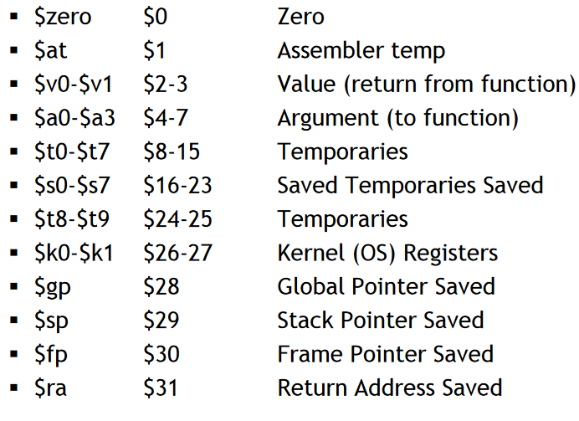
Register Correspondence

Slide 26
End

